Slide 1
Introduction to Bootstrap 5

Slide 2
What is Bootstrap and Why Use it?
Free, open-source front-end framework
Provides ready-made CSS and JS components
Makes websites responsive & mobile-friendly
Saves development time and ensures consistency

Slide 3
Bootstrap CDN vs Local Setup
CDN (Content Delivery Network):
Quick to start, requires internet
Example: Link Bootstrap files online
Local Setup:
Download Bootstrap files into project
Works offline, customizable

Slide 4
File Structure & Integration with HTML
Typical Project Structure:
index.html
css/bootstrap.min.css
js/bootstrap.bundle.min.js
style.css (custom)
Include Bootstrap CSS before your own styles.

Slide 5
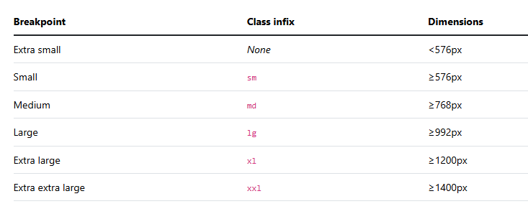
Responsive Breakpoints

Slide 6
Responsive Breakpoints
Breakpoints define layouts for different screen sizes:
col- (extra small <576px)
col-sm- (small ≥576px)
col-md- (medium ≥768px)
col-lg- (large ≥992px)
col-xl- (extra large ≥1200px)
col-xxl- (extra extra large ≥1400px)

Slide 7
What is Container?
A container is the main layout wrapper in Bootstrap.
It aligns content properly on the page.
It provides responsive padding and margin.
It is required for using the Bootstrap grid system.

Slide 8
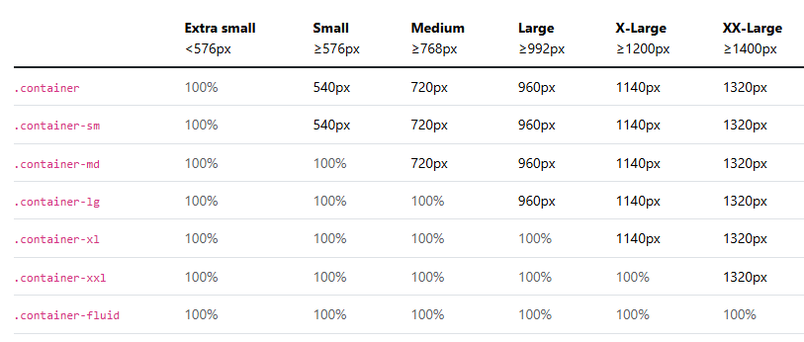
Container
We use container and container fluid for 100% almost
container fluid for 100% and only container for
Container for mid part

Slide 9
Grid:
What is the Grid System?
The Bootstrap Grid System is a layout system that allows you to create responsive web page layouts using rows and columns.
It is based on a 12-column system.
This means:
Each row is divided into 12 columns.
You can combine these columns in different ways to create layouts.

Slide 10
Bootstrap Grid System
Layout based on 12-column grid
Container: wrapper for rows and columns
Row: horizontal group of columns
Column: defined with col- classes (e.g., col-6)
Example: col-6 + col-6 = full row

Slide 11
Columns in Bootstrap
Columns are used to divide a row into different sections.
Bootstrap uses a 12-column layout system, which means: Each row has 12 available columns.
Vertical Alignment of Columns: Vertical alignment is controlled on the row.
Classes:
align-items-start → Top
align-items-center → Center
align-items-end → Bottom
Horizontal Alignment of Columns: It is also controlled on the row
Classes:
justify-content-start
justify-content-center
justify-content-end
justify-content-between
justify-content-around
justify-content-evenly

